Slide 1
Proton therapy
Meeting Oslo

Slide 2
Protontherapy – technical development
1954 first protontreatment: irradiation of the pituitary gland as antihormonal treatment for breast cancer (USA)
1957 first protontreatment in Uppsala
1990 first protontreatment in a hospital environment (USA)
Until now > 200.000 patients treated globally, approximately 100 facilities worldwide
Nordic countries: Uppsala, Aarhus, soon also Oslo and Bergen

Slide 3
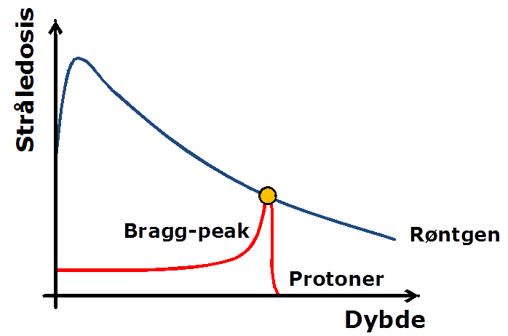
Notes:
Her ses en kurve for hvordan protoner afsætter sin energi, med en lav indgangsdosis indtil target, hvor den peaker (det kaldes bragg peak). Efter bragg peak afgives ingen stråling.
Den manglende build up effect med protoner kan få betydning for øget huddosis, men det kan løses ved at afgive behandlingen fra flere vinkler.

Slide 4

Lowdose
No dose
IMRT
Highdose
Protons

Slide 5
Advantage of proton RT
Less dose to normal tissue
Potential for less radiation induced
toxicity
Important for long time survivors
(Potential for dose escalation)

Slide 6

Medulloblastompatients are at a high risk for treatment induced late effects
intracranial
extracranial
Neurocognitive late effects
Endocrine late effects
Neurovascular toxicity
Catarakt
Hearling impairment
Fatigue
54 Gy
2ndary Cancer
Cardiopulmonal late effects
24-36 Gy
hematological
Gastrointestinal acute effects
Fertility problems because of radiation
to the ovaries

Slide 7
Less risk for development especially of extracranial
toxicity
But also from impact of the boost in the brain
Jørgen B. Pedersen

Slide 8
 | Diagnosis | Dapho-Strategy
Brain tumours: | CSI | Protons
 | Germinoma, AT-RT, Ependymoma, LGG | Protons
 | Craniopharyngioma | Comparative Plan
 | Grade III glioma | Comparative Plan
 | Gr IV glioma, DIPG | Photons
Sarcoma: | Parameningeal, pelvin, paravertebral | Protons
 | Extremities | Photons
 | Others | Comparative Plan
Others: | Lymphoma, Nephroblastoma, Neuroblastoma | Comparative Plan
We have local and national MDTs for brain tumours and solid tumours were the DCPT is participating.
All international patients are also presented at our local MDT

Slide 9
Proton therapy
Sparing of organs at risks
Will be depending on how far the OAR is from the tumour or tumourbed
If the OAR is near, it might be difficult or impossible to spare
If further away, it might be easier to spare with proton therapy
Interesting for sparing of the pituitary / hypothalamic axis, cochleae, hippocampus

Slide 10

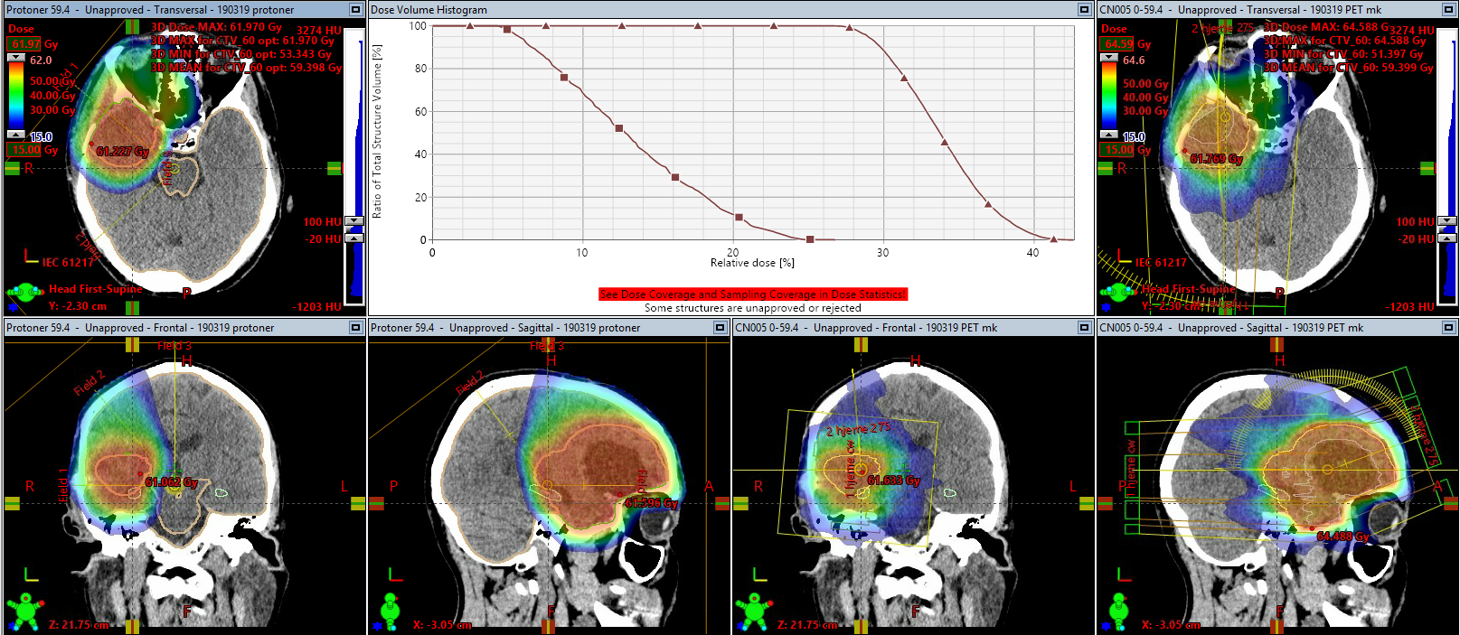
Glioma gr III adult patient
Pituitary gland
Morten Høyer

Slide 11
Clinical studies: effect of proton RT
Local control with proton- and photon RT is the same in standard risk medulloblastoma
IJROBP 2016;94(1):133-8
Pattern of failure in medulloblastoma are similar after proton- and photon treatment
Sethi et al, IJROBP. 2014;88(3):655-663

Slide 12
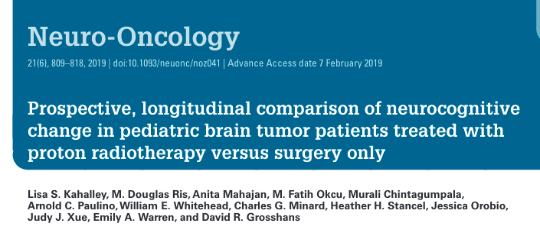

Neurocognition after focal RT
22 proton CSI
31 proton fokal RT
40 surgery only
6 yrs neurocognitive follow up

Slide 13
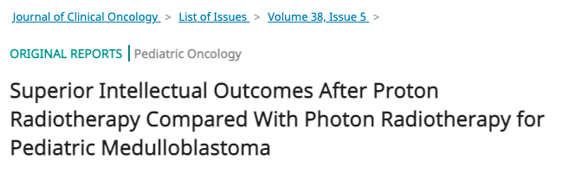
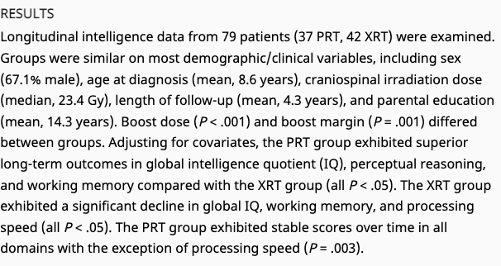

Slide 14
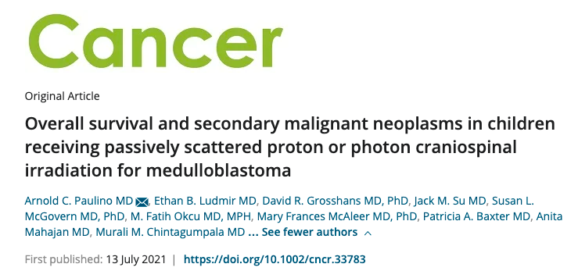
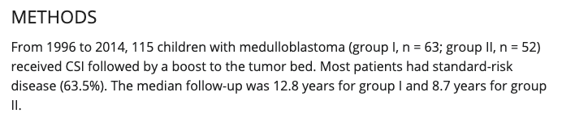

Slide 15
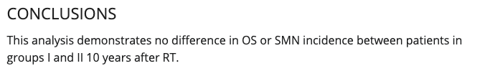

Slide 16
Disadvantage of Proton RT
Treatment delays because of non availability
Protons have a very precise range
disadvantage for moving targets (breathing, thorax, abdomen)
sensible for changes in anatomy (weight loss, CSF leaks, air when treating the abdomen, pelvis …)
If metal or other material is in the treatment path, it is important for the physicists to know what it consists of to calculate the beampath correctly

Slide 17
Variable RBE at the end of the beampath ?
Normally the effectiveness of protons can be converted by a factor 1.1 to photons
1 proton Gy = 1.1 photon Gy
Potential for variabilities in RBE at the end
of the beam that can give challenges if
directed at an organ at risk

Slide 18
Increased risk for brainstem necrosis after pediatric proton RT ?
Image changes (transient or irreversible) with or without symptoms have been seen after photon and proton RT with a risk with both modalities < 5%
Because of the potential variable RBE the brainstem is a focus for centers delivering proton therapy ( as few beams as possible should abut to the brainstem, careful dose planning, doi: 10.1016/j.ijrobp.2018.01.013.
Recent literature is encouraging, DOI: 10.1080/0284186X.2019.1659996
Radiobiological planning
European workshop about proton therapy planning regarding pediatric fossa posterior tumours in Aarhus in November 2022

Slide 19
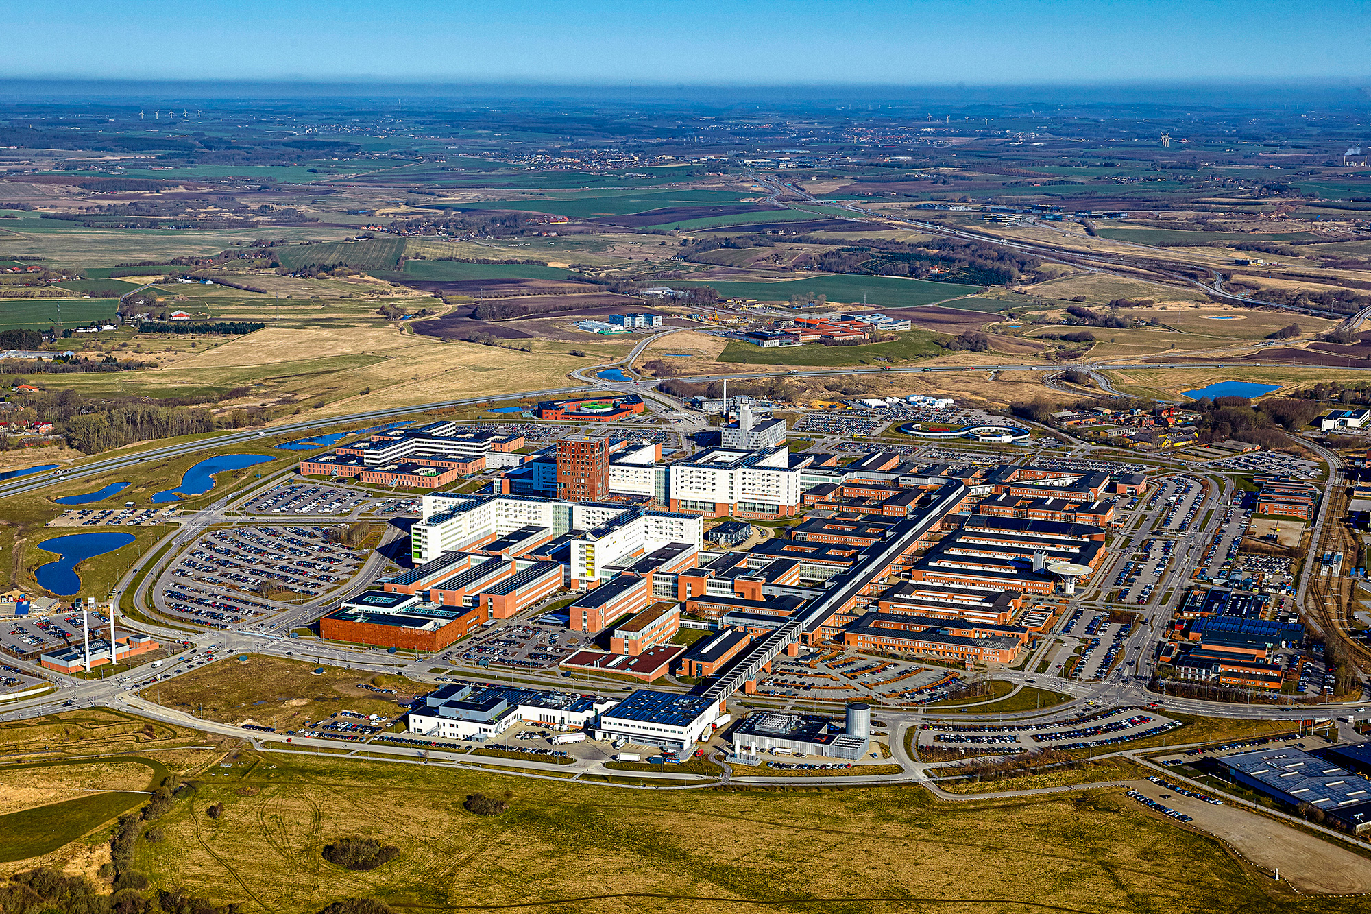
The Danish Centre for Particle Therapy (DCPT)

Slide 20
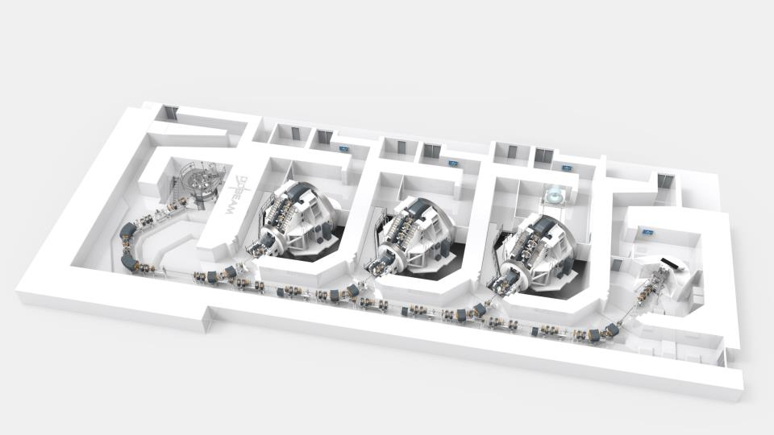
Cyclotrone

Slide 21
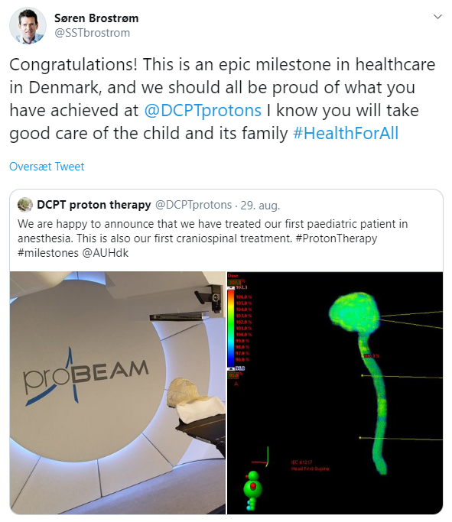
The pediatric experience at the DCPT
Start January 2019
Treatment of first child August 2019
Jan 2019-1st quarter 2022 treatment of 546 patients

Slide 22

Main tumor groups
Others:
Lymphoma
Seminoma
Cervical cancer (LN)
Oesophagus
Prostate
Liver
Lung

Slide 23
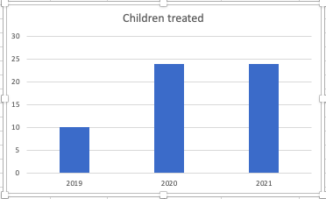
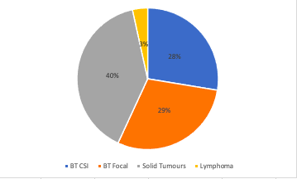

Slide 24
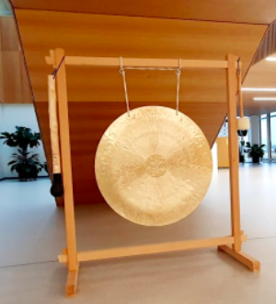

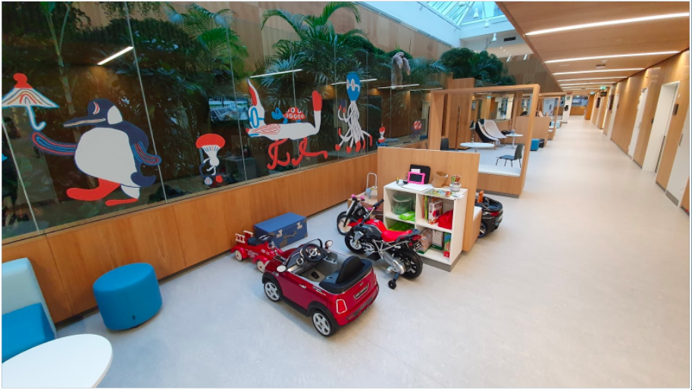
Organisation of pediatric RT
Dedicated treatment teams
Childfriendly environment
Tight collaboration with the pediatric oncologists, shared consultations etc.
Very flexible anesthesia team, Propofol, recovery room in DCPT
Physiotherapy, ergotherapy and psychological support in the pediatric department if indicated
“Hands on Day”
3 D-cinema
Trykfondens family house

Slide 25
Plan audits / protocols
All doseplans are reviewed
National conference
Biweekly Swedish conference
QUARTET ( if in protocol)
PNET 5 (closed)
HR-MB
Ependymoma II
Far RMS
SIOPEN II
Umbrella
AT-RT (not yet activated)
HARMONIC
Several national research protocols on neurocognition, image changes, neurovascular changes, musculoskeletal changes after pediatric RT

Slide 26
